Slide 1

Principal Component Analysis Applied to Neuroscience and Cognitive Science
CA6b Course Project
Machens, C. K., Romo, R., & Brody, C. D. (2010). Functional, but not anatomical, separation of “what” and “when” in prefrontal cortex. Journal of Neuroscience, 30(1), 350-360.
Leïla Abbih, Nicole Miller & Kexin Ren

Slide 2
Goal
Work Goal :
Study working memory and how the brain stores information
Method Goal :
Reduce heterogeneity of PFC activity
Separate it into components to make it easier to interpret
Separation between time-related and memory-related activity
Notes:
neural activity that occurs in the absence of external stimulation is persistent activity—often associated with the active maintenance of short-term memory information in the brain
short-term memory of items or values is thought to be stored in the persistent activity of neurons in higher cortical areas.

Slide 3
Content
INTRODUCTION
REPRODUCTION
CONCLUSION & DISCUSSION

Slide 4
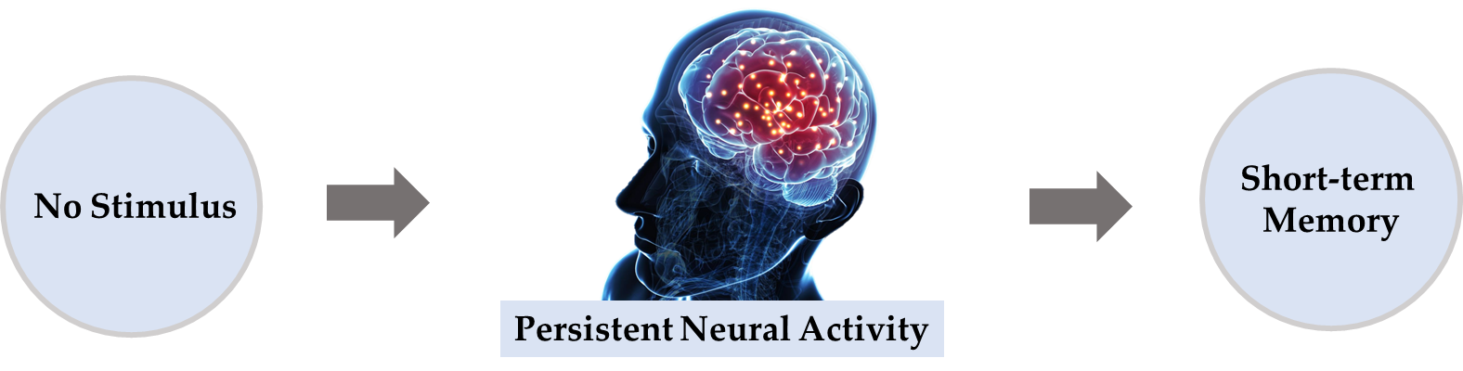
Introduction
Notes:
neural activity that occurs in the absence of external stimulation is persistent activity—often associated with the active maintenance of short-term memory information in the brain
short-term memory of items or values is thought to be stored in the persistent activity of neurons in higher cortical areas.

Slide 5
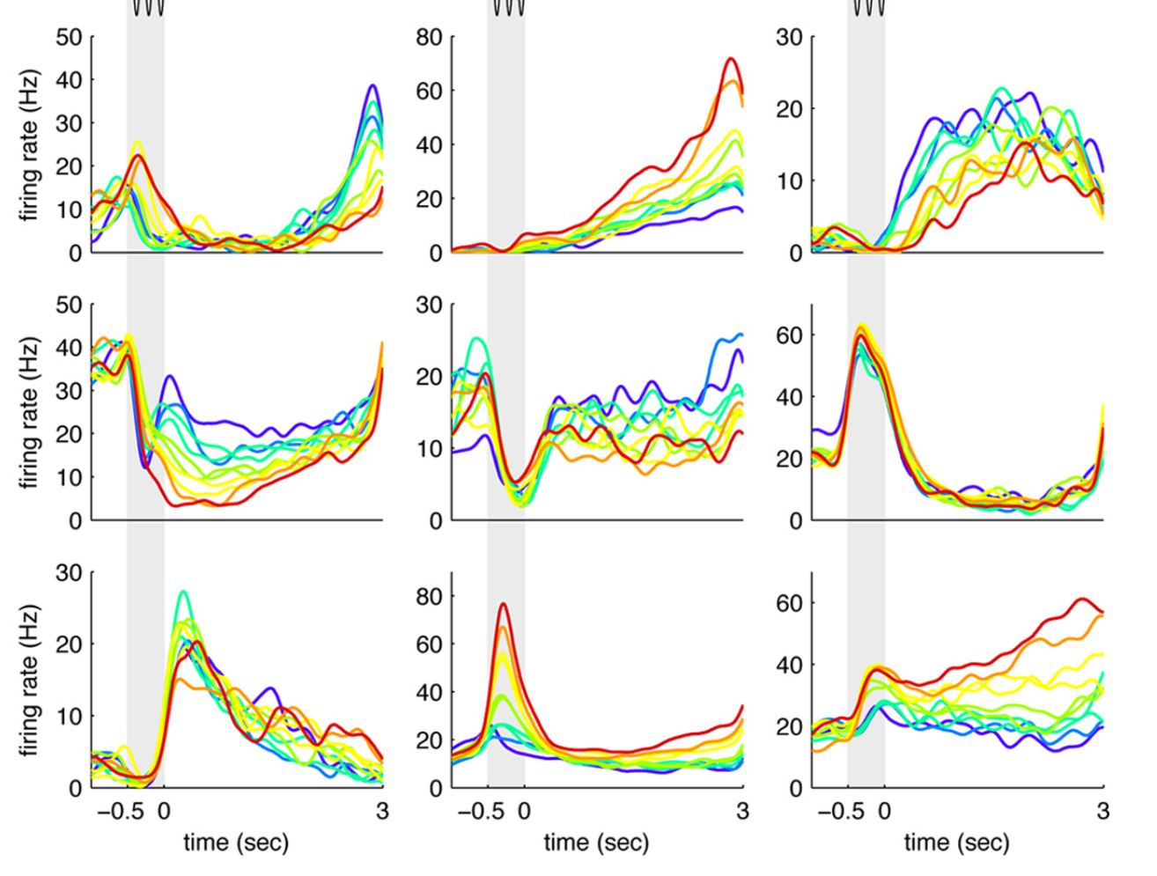
Introduction
neurons
time
Varying Neural Activities
Notes:
the activity of these neurons often varies strongly in time, even if time is unimportant forwhether or notrewards arereceived.

Slide 6
Introduction
neurons
?
time
Varying Neural Activities
Notes:
the activity of these neurons often varies strongly in time, even if time is unimportant forwhether or notrewards arereceived.
different neurons have highly heterogeneous patterns of activity, making interpretation of the data difficult.

Slide 7
Introduction
neurons
dim
Representation
?
time
Varying Neural Activities
Notes:
--> representation of data to reduce heterogeneity

Slide 8
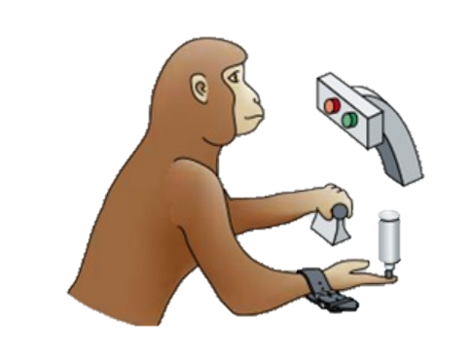
Introduction
3 monkeys
RR013
RR014
RR015
Experiment
Notes:
Two brief (0.5 s)vibratory stimuli - range 6– 40 Hz

Slide 9
Introduction
1st mechanical
vibrations
freq = f1
3 monkeys
RR013
RR014
RR015
0
0.5
time/s
Experiment
Notes:
Two brief (0.5 s)vibratory stimuli - range 6– 40 Hz

Slide 10
Introduction
Remember f1
Delay Period
freq = 0
3 monkeys
RR013
RR014
RR015
0
0.5
3.5
time/s
Experiment
Notes:
Hold f1

Slide 11
Introduction
2nd mechanical
vibrations
freq = f2
3 monkeys
RR013
RR014
RR015
0
0.5
3.5
4
time/s
Experiment
Notes:
Two brief (0.5 s)vibratory stimuli - range 6– 40 Hz

Slide 12
Introduction
2 decisions
f1 > f2?
f2 > f1?
3 monkeys
RR013
RR014
RR015
0
0.5
3.5
4
time/s
Experiment
Notes:
Two brief (0.5 s)vibratory stimuli - range 6– 40 Hz

Slide 13
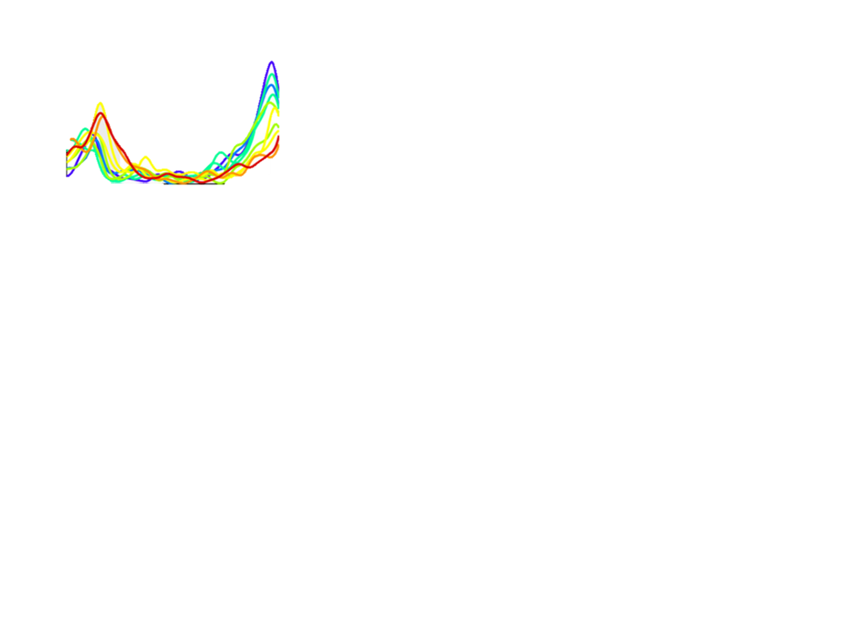
Introduction
Remember f1
Delay Period
freq = 0
3 monkeys
RR013
RR014
RR015
firing rate
0
0.5
3.5
time/s
Experiment
Notes:
Hold f1

Slide 14
Content
INTRODUCTION
REPRODUCTION
CONCLUSION & DISCUSSION

Slide 15
Reproduction
Data Preprocessing
PCA
dPCA

Slide 16
Data
One monkey RR014
85 files Different recordings
Each file contains several columns the important ones are:
“Trial” for trial number
“Hit” for the answer of the monkey (right or wrong)
“f1” value of initial frequency
“f2” value of final frequency
“Spikes” collection of 9 arrays, one for each electrode
Each array: t [ms] where the neuron presented a spike
Some electrodes were not correctly collecting the activity so we need to remove them
Data source: Previously reported dataset collected from the PFC of monkeys (Romo et al., 1999; Brody et al., 2003; Romo and Salinas, 2003).
Original Data
Notes:
Hold f1

Slide 17
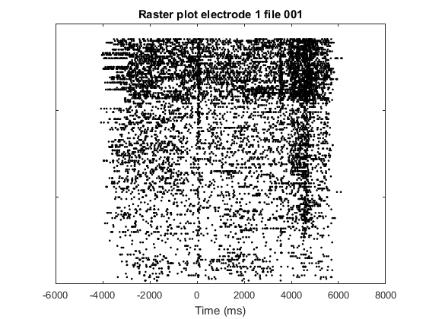
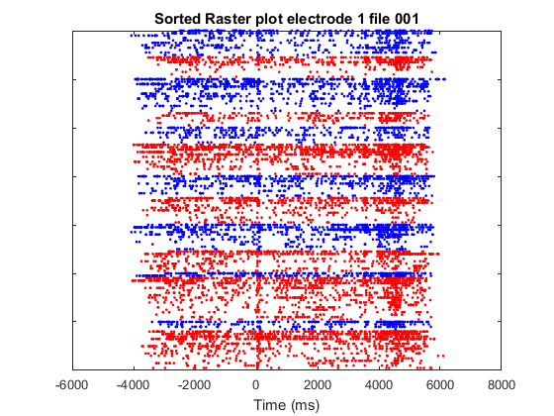
Raw data
Raster plots with the spike trains of the neurons.
Better Plot Sorting the data
By f1 frequency
Separating by condition
Condition 1: f1 < f2
Condition 2: f1 > f2
f1
34
30
26
22
18
14
Data : Original Data
10

Slide 18
Only interested in activity during the delay period (3 seconds window)
We only care about f1 values
[10, 14, 18, 24, 30, 34]
Values with the highest numbers of trials
Keep group separation because
these are different experimental conditions
Moving from spikes trains to PSTH:
Discretization of time
Group all data by values of f1
Group all data by conditions
Average over all trials for each group formed
Convolute these averages with gaussian kernel
to smooth the activity
f1
34
30
26
22
18
14
10
Data : PSTH
Notes:
Hold f1

Slide 19
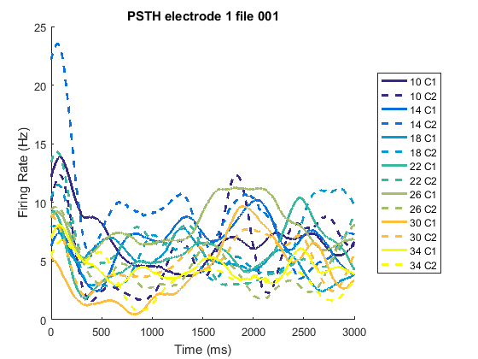
Only interested in activity during the delay period (3 seconds window)
We only care about f1 values
[10, 14, 18, 24, 30, 34]
Values with the highest numbers of trials
Keep group separation because
these are different experimental conditions
Moving from spikes trains to PSTH:
Discretization of time
Group all data by values of f1
Group all data by conditions
Average over all trials for each group formed
Convolute these averages with gaussian kernel
to smooth the activity
Data : PSTH
Notes:
Hold f1

Slide 20
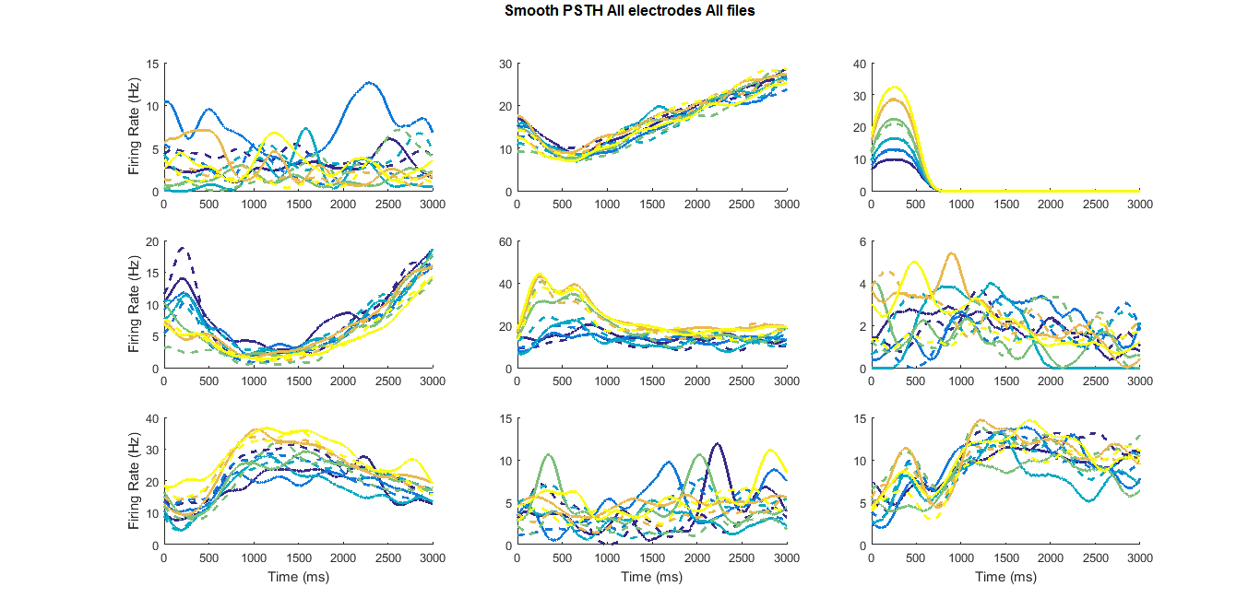
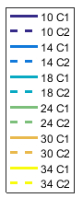
Data : Transformed Data
Notes:
Hold f1

Slide 21
Reproduction
Data Preprocessing
PCA
dPCA

Slide 22
PCA
multivariate dataset
 | V1 | V2 | … | Vn
N1
N2
…
Nm
Principle Component Analysis
Basic idea
PCA
new coordinates
x3
x1
account for variance
as much as possible
x2
Notes:
new coordinate system → the first coordinate accounts for as much of the variance in the data as possible, the second coordinate for as much of the remaining variance as possible, and so on

Slide 23
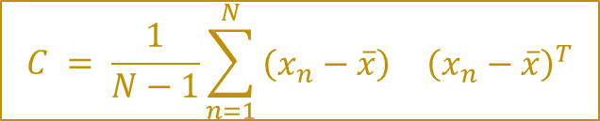
PCA
Original matrix
x₁₁
…
x_{1n}
…
…
…
x_{m1}
…
x_{mn}
Principle Component Analysis
Basic idea
Algorithm
$$C = \frac{1}{N−1}\sum_{n=1}^{N}{\begin{matrix}\left(x_{n}−\overline{x}\right) & {\left(x_{n}−\overline{x}\right)}^{T}\end{matrix}}$$
Covariance matrix: C
Eigenvalues of C: D
Eigenvectors of C: V
Percentage of var explained
Principle components
$C =VDV^{T}$
New data
New coordinate system
Notes:
new coordinate system → the first coordinate accounts for as much of the variance in the data as possible, the second coordinate for as much of the remaining variance as possible, and so on

Slide 24
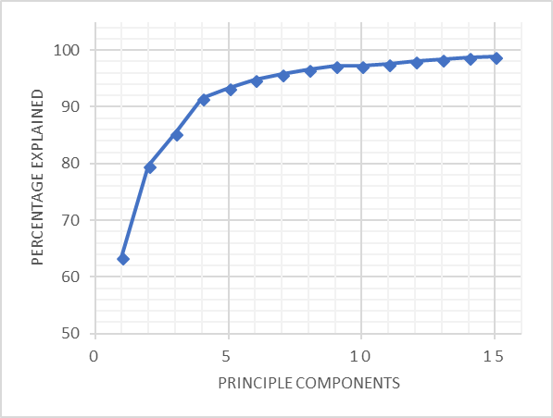
PCA
Choose K (# comp)
Principle Component Analysis
Basic idea
Algorithm
Implementation
K = 7 → 95% variance explained
Notes:
new coordinate system → the first coordinate accounts for as much of the variance in the data as possible, the second coordinate for as much of the remaining variance as possible, and so on

Slide 25
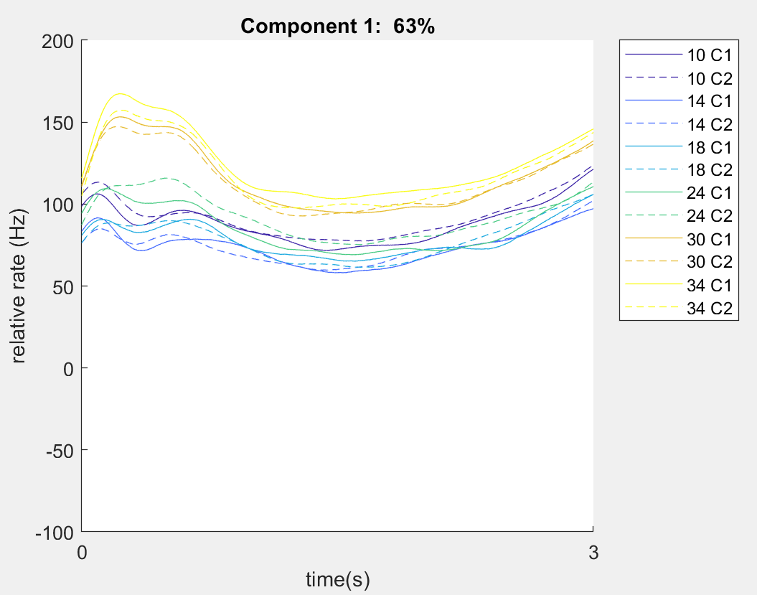
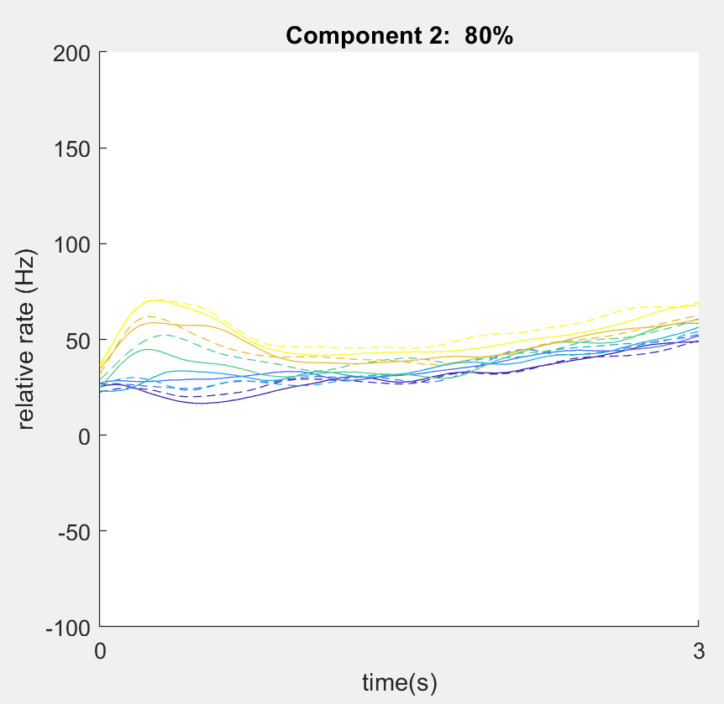
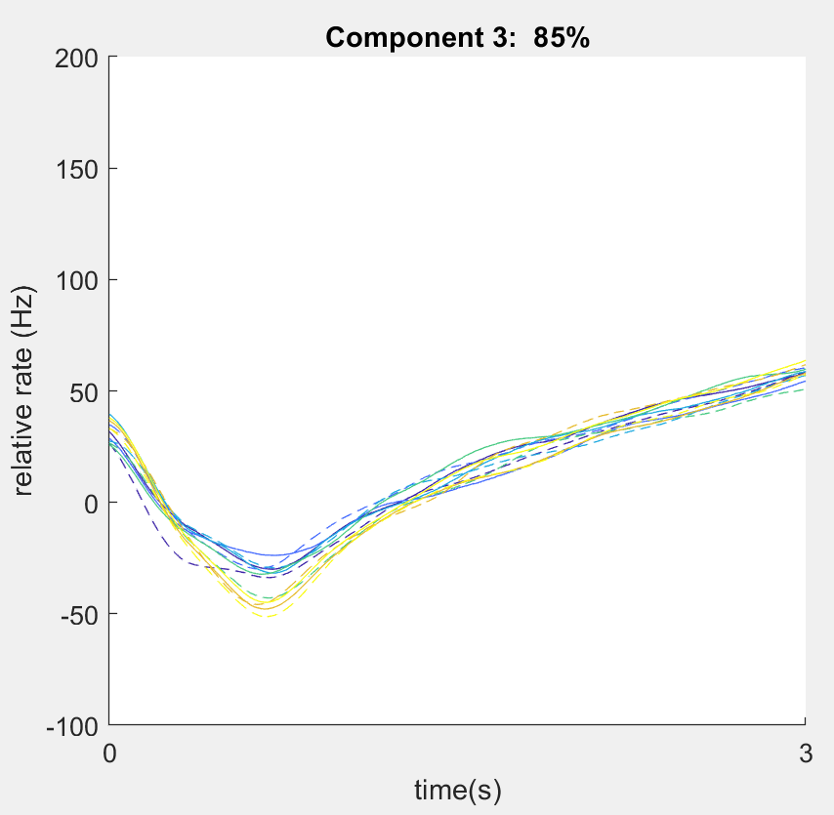
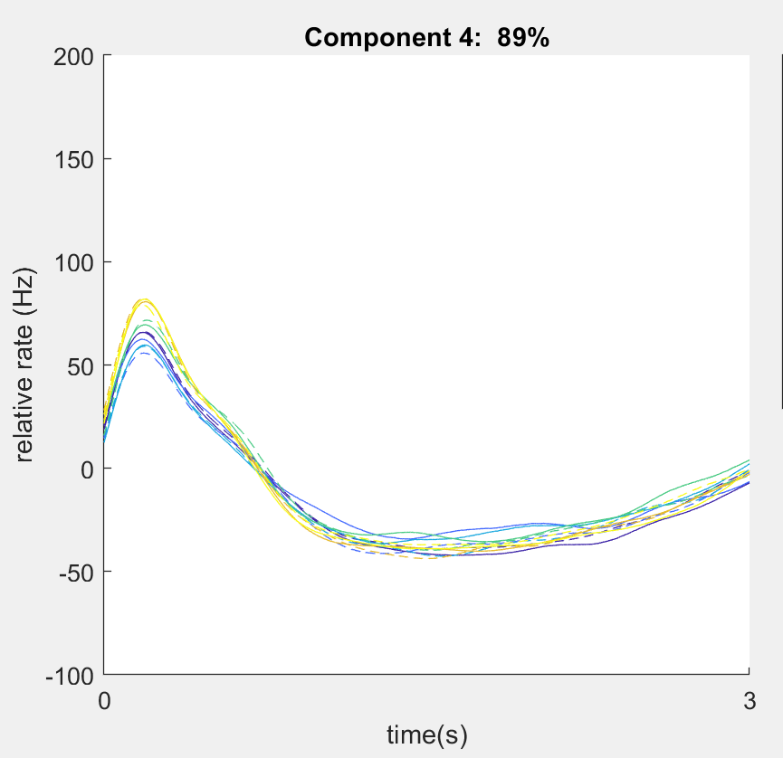
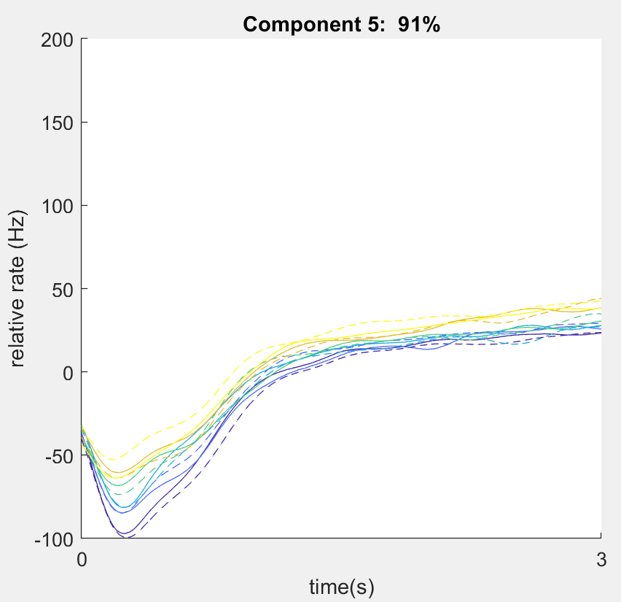
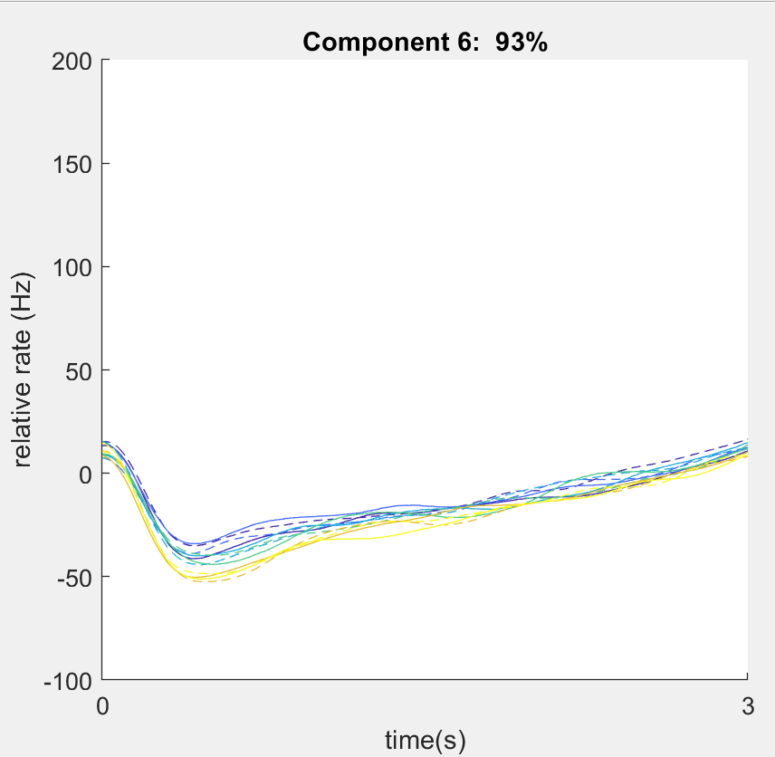
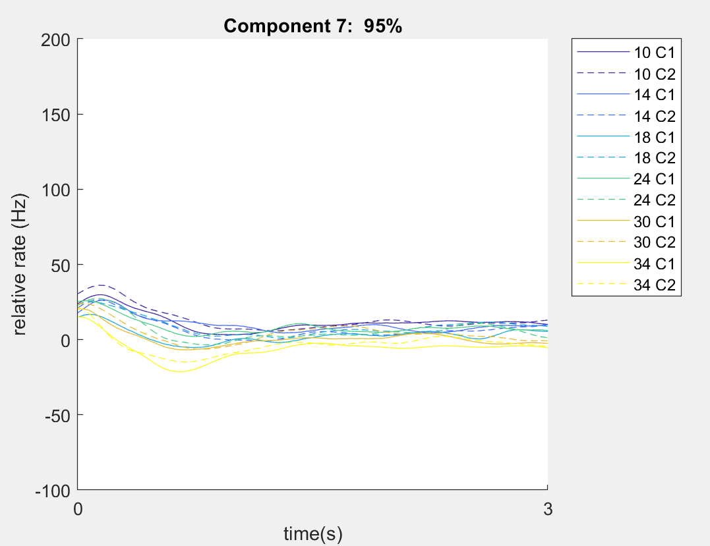
PCA
First 7 Components (dif data of paper)
Principle Component Analysis
Basic idea
Algorithm
Implementation
Covariance & Eigenvalues
Notes:
new coordinate system → the first coordinate accounts for as much of the variance in the data as possible, the second coordinate for as much of the remaining variance as possible, and so on

Slide 26
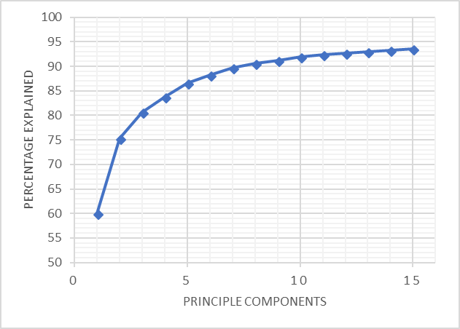
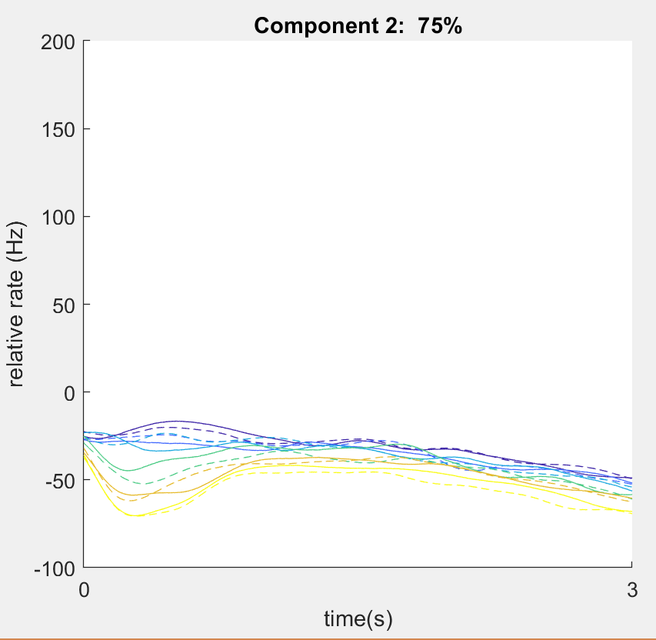
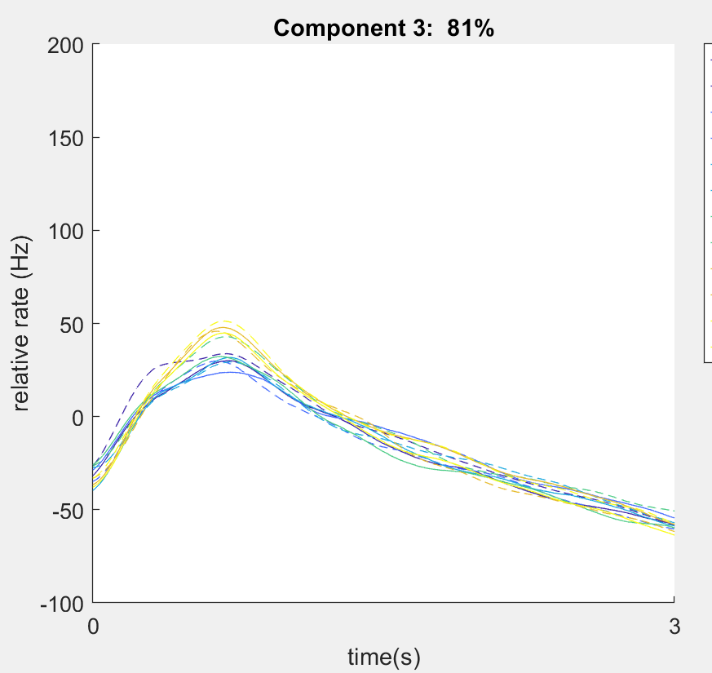
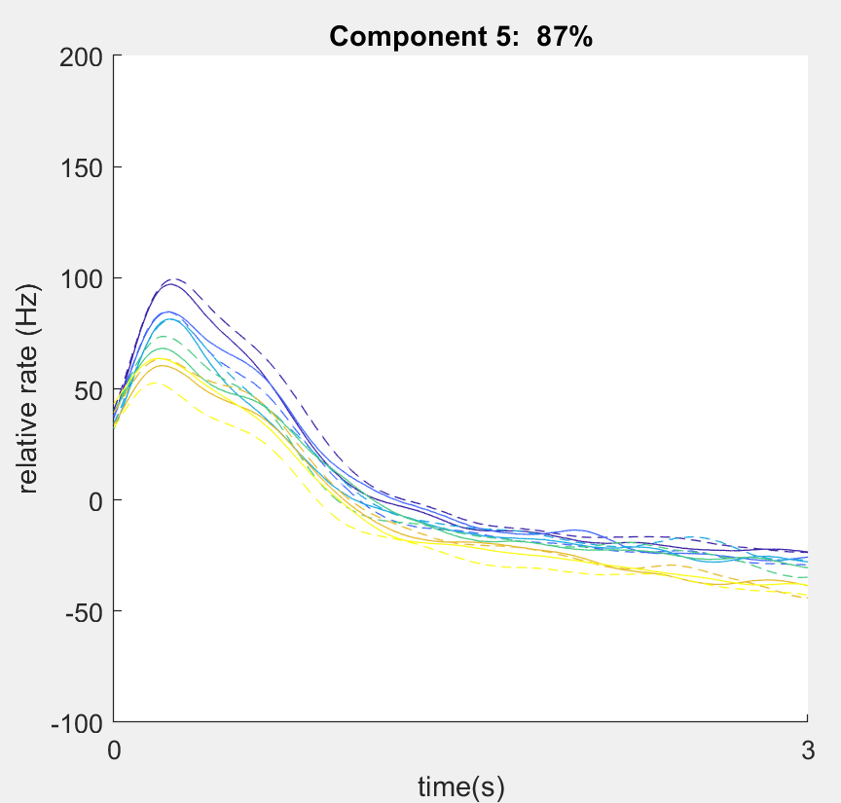
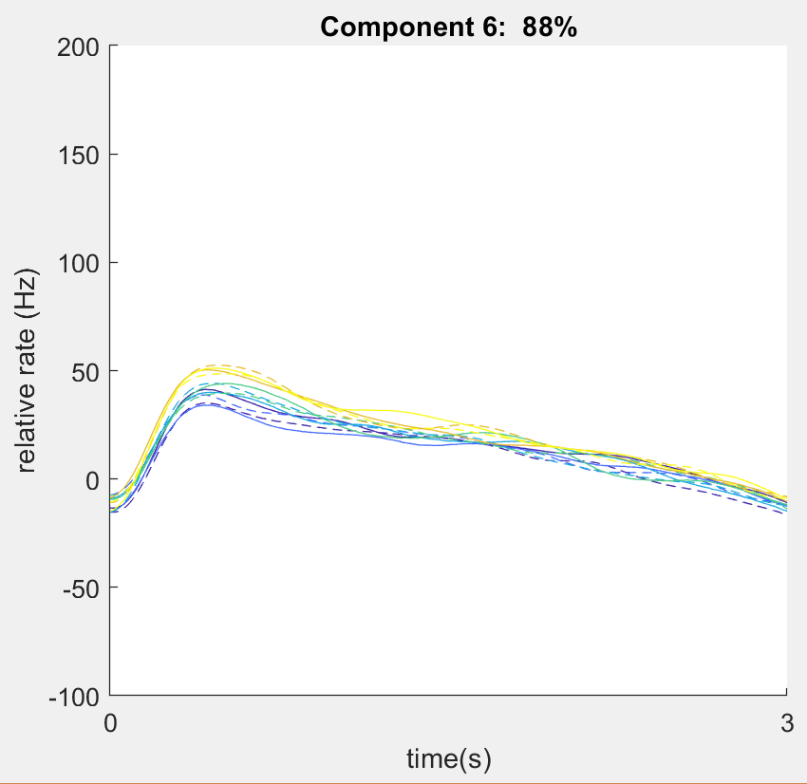
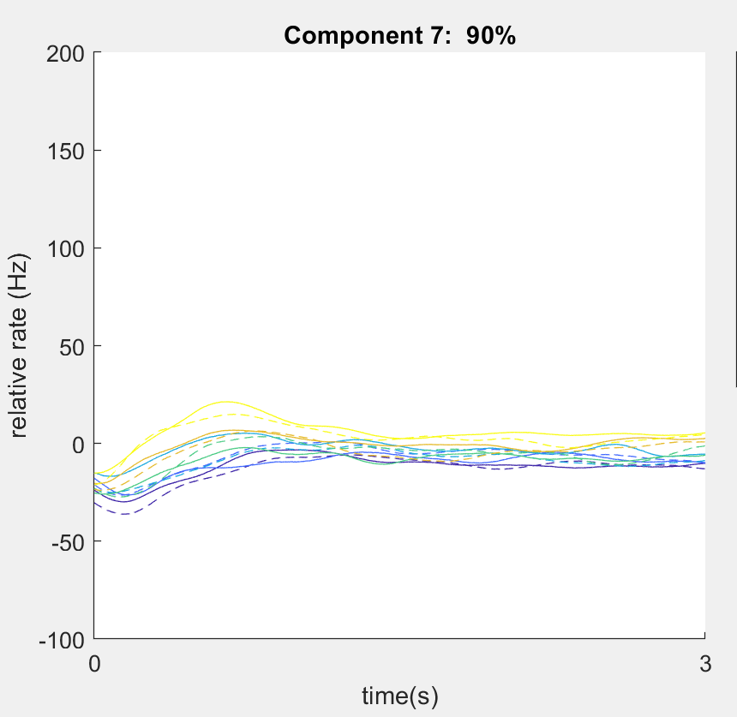
PCA
Compare with pca() function in matlab
Differences:
Slightly dif percentage
Flipped plots for comp 2, 3, 5, 6, 7
Principle Component Analysis
Basic idea
Algorithm
Implementation
Covariance & Eigenvalues
pca() function
Notes:
new coordinate system → the first coordinate accounts for as much of the variance in the data as possible, the second coordinate for as much of the remaining variance as possible, and so on

Slide 27
PCA
Compare with pca() function
Differences:
1. Slightly dif percentage
data noise
Flipped plots for comp 2, 3, 5, 6, 7
→ ?
Principle Component Analysis
Basic idea
Algorithm
Implementation
Covariance & Eigenvalues
pca() function
Notes:
new coordinate system → the first coordinate accounts for as much of the variance in the data as possible, the second coordinate for as much of the remaining variance as possible, and so on

Slide 28
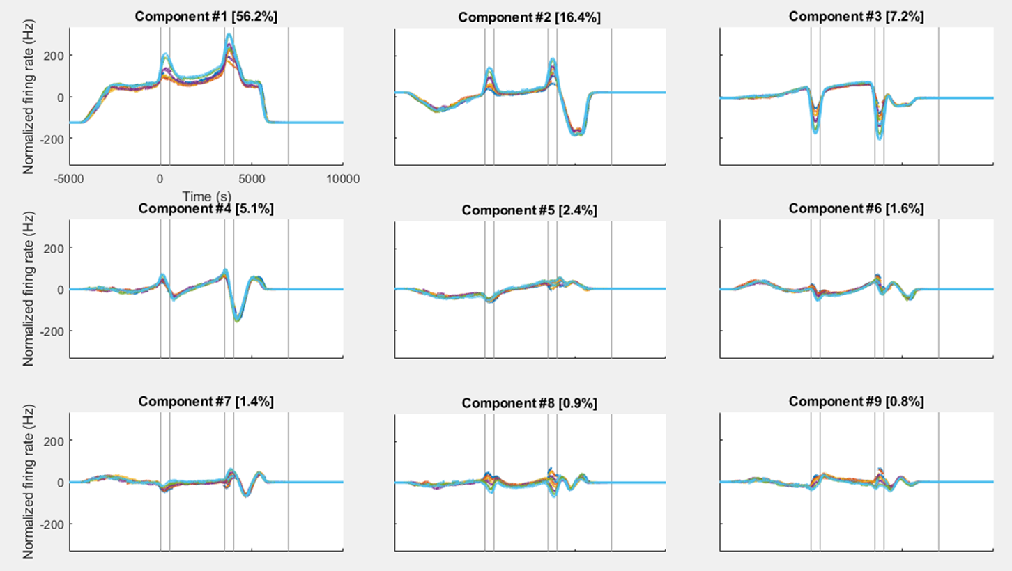
PCA
Compare with dPCA toolbox pca() function
Principle Component Analysis
Basic idea
Algorithm
Implementation
Covariance & Eigenvalues
pca() function
dPCA toolbox (Kobak et al., 2016)
Notes:
new coordinate system → the first coordinate accounts for as much of the variance in the data as possible, the second coordinate for as much of the remaining variance as possible, and so on

Slide 29
Reproduction
Data Preprocessing
PCA
dPCA

Slide 30
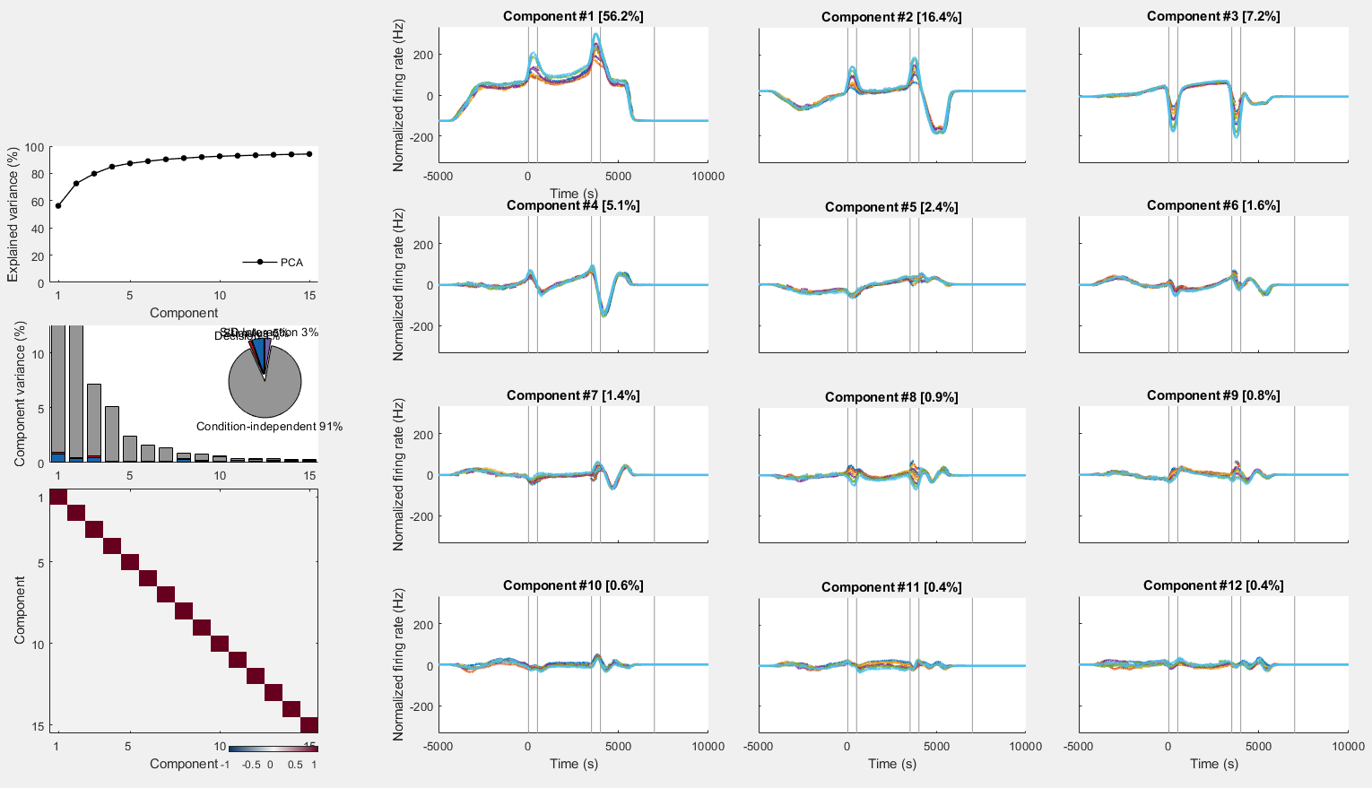
PCA
f1
f2
cue

Slide 31
PCA
f1
f2
cue
Cumulative variance explained by PCA
First principal components

Slide 32
PCA
f1
f2
cue
Variance of the individual demixed principal components
They are not demixed!

Slide 33
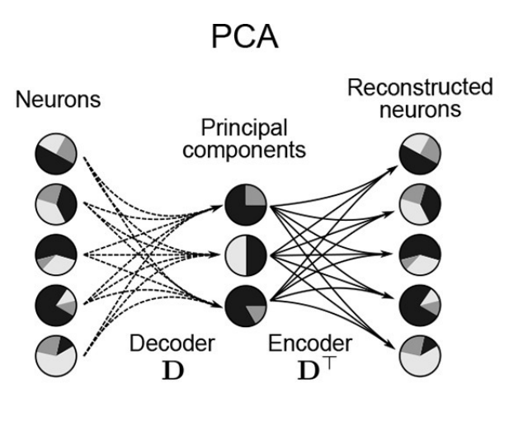
PCA
Rank Reduction
Unsupervised method : information about the parameters (stimulus, decision, subject's level confidence) are not taken into account
The data is not easily interpretable
Kobak et al 2016
Notes:
new coordinate system → the first coordinate accounts for as much of the variance in the data as possible, the second coordinate for as much of the remaining variance as possible, and so on

Slide 34
DoC
Difference of Covariance Technique
The firing rates in the new coordinates are averaged over frequencies and time
A PCA is applied on the difference of the two covariance matrixes
The DoC separates well the time and frequency variable in the article, but it does not generalize well to more variables
Kobak et al 2016
Notes:
new coordinate system → the first coordinate accounts for as much of the variance in the data as possible, the second coordinate for as much of the remaining variance as possible, and so on

Slide 35
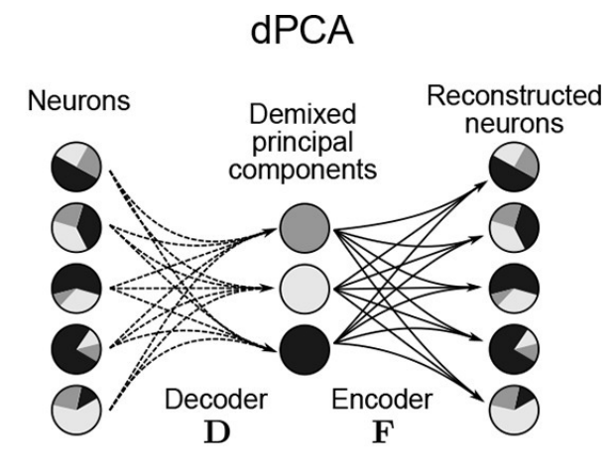
dPCA
Dimensionality Reduction method that decomposes the data
Demix the experimental task parameters
Preserve the original data as much as possible
Kobak et al 2016
Notes:
new coordinate system → the first coordinate accounts for as much of the variance in the data as possible, the second coordinate for as much of the remaining variance as possible, and so on

Slide 36
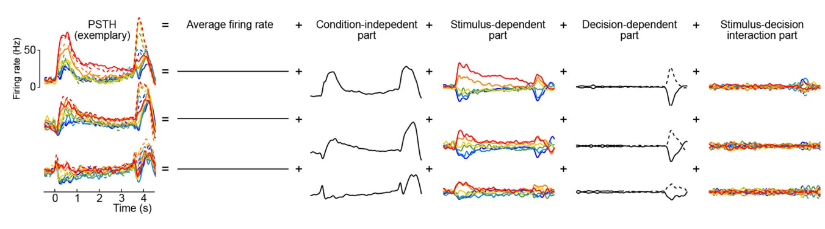
Marginalization Procedure: the data is averaged over different task parameters
This method compresses and demixes the dependencies of the data
Standardized procedure for different types of data sets
Needs a lot of neurons Doesn't work well with unbalanced sets

Slide 37
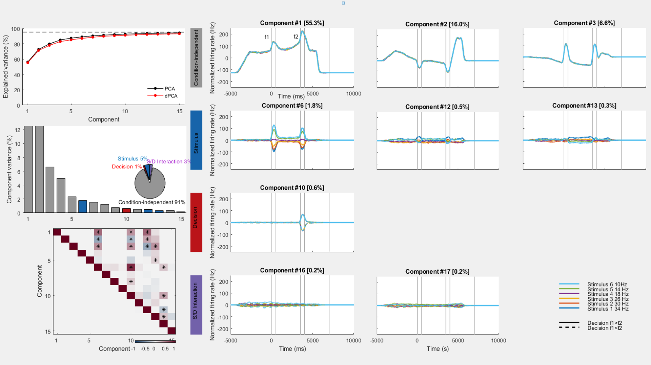
dPCA

Slide 38
dPCA
First 3 condition-independent components

Slide 39
dPCA
First 3 stimulus components

Slide 40
dPCA
First decision component

Slide 41
dPCA
First 2 stimulus/decision interaction component

Slide 42
dPCA
Cumulative variance explained by PCA and dPCA (without removing the noise)

Slide 43
dPCA
Variance of the individual demixed principal components
Notes:
Nearly perfect demixing

Slide 44
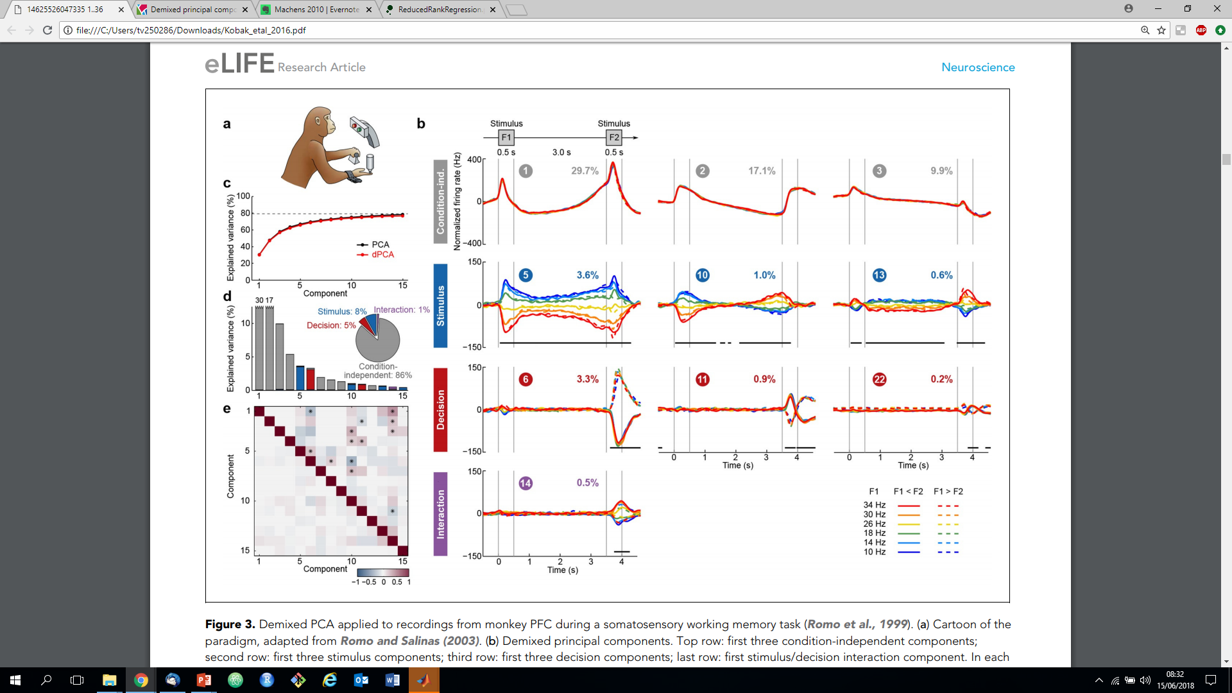
The DoC
The Kobak et al data

Slide 45
Content
INTRODUCTION
REPRODUCTION
CONCLUSION & DISCUSSION

Slide 46
Conclusion
What we’ve done
Data preprocessing : Very hard to do accurately
Dimension reduction by PCA : Different methods, different results
Dimension reduction by dPCA : Promising
What we’ve learned
Matlab coding
Neural data preprocessing
PCA algorithm
dPCA toolbox

Slide 47
Discussion
What were difficult
Understanding data structure
Understanding different results between ours and paper’s
Understanding differences among all PCA methods compared: Where are the differences coming from?

Slide 48
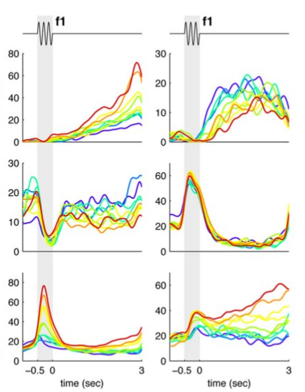
Discussion
Our Results
Paper Results

Slide 49
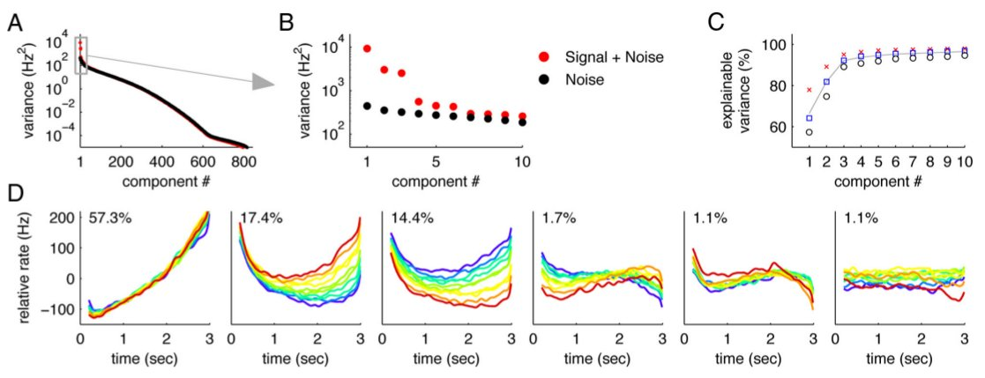
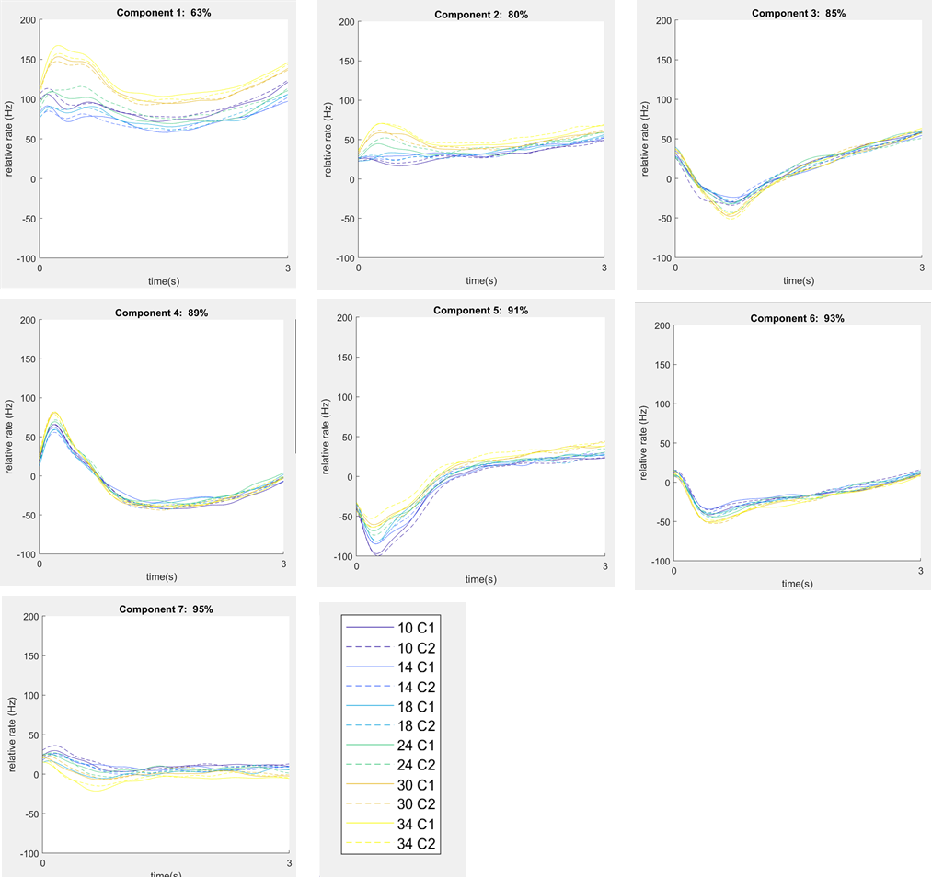
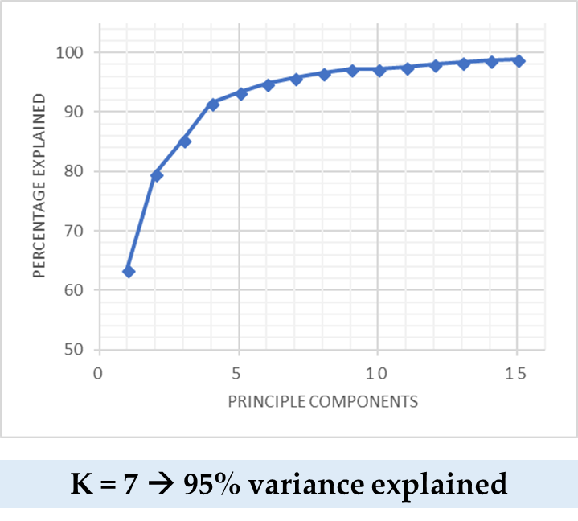
Discussion
Paper Results
Our Results

Slide 50
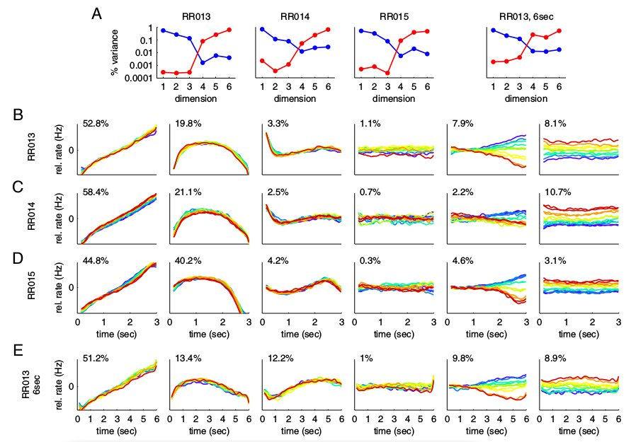
Kobak et al Results dPCA
Paper Results DOC
The Kobak et al data
Our Results

Slide 51
Thank You

Slide 52
Experiment
Process
training
Neurophysiological recordings:
Single neuronal activity → seven independently movable microelectrodes
inserted in parallel into the inferior convexity of the PFC of
the left hemisphere of the three monkeys
rhe right hemisphere of two monkeys (RR013 and RR015).
neurons preselected → not necessary ((PCA) will eliminate any non-task-related activity)
500 ms windows (1) before the onset of stimulus f1, (2) during the presentation of stimulus f1, (3) at the beginning of the delay period, (4) at the end of the delay period, and (5) during the presentation of stimulus f2.
one-way ANOVA test
→ 842 cells for monkey RR013; 161 cells for monkey RR014, 361 cells for monkey RR015, and 123 for monkey RR013 with a 6 s delay period.
Delay period: subject is holding the value of f1 in short-term memory.
Spike trains → Gaussian kernel filter
Delete first 150 ms → eliminate transient firing rate changes from the presentation of stimulus f1
→ firing rate time varying: r_k_i(t,f) – i neuron, k trial,

